Slide 1
Consistent Right-Invariant Fixed-Lag Smoother with Application to Visual Inertial SLAM
Jianzhu (Josh) Huai, Yukai Lin, Yuan Zhuang, Min Shi
The Thirty-Fifth AAAI Conference on Artificial Intelligence (AAAI 2021)
Primary Subject Area: ROB: State Estimation
2021-1-2
Notes:
Hi I am Jianzhu Huai, a postdoc researcher from Wuhan University. Today I’ll present the work “title”. This work is done in collaboration with Yukai Lin from Huawei, Professor Zhuang Yuan from Wuhan University, and Professor Shi Min from Washington University St Louis.

Slide 2
Content
Estimator inconsistency and why
Existing approaches
Right invariant fixed-lag smoother
Conclusion
Notes:
As a brief outline of the presentation today, I'm first going to describe estimator inconsistency problem and look into its causes.
Then, existing approaches for fixing inconsistency in traditional geometrical estimators are reviewed.
Next I’ll describe the proposed method for ensuring consistency of fixed lag smoothers by using right invariant errors.
Finally the presentation concludes with a recap.

Slide 3
Estimators
Estimators
Geometrical
Deep learning
Hybrid
Bundle adjustment
iSAM2
Fixed-lag smoothers
Filters
Notes:
To begin let me attempt to classify existing estimators. Depending on whether training is necessary,
estimators can be grouped into geometrical ones, those based on deep learning, and hybrid ones.
The geometrical estimators can be further grouped into bundle adjustment, incremental smoothing and mapping, fixed lag smoothers, and filters, depending on whether variables are marginalized from the estimation problem.

Slide 4
Inconsistent estimation
Notes:
With that background, it has been shown that some estimators give inconsistent covariances when the problem has unobservable directions.
For instance, the visual inertial SLAM has 4 unobservable directions, one for rotation about gravity, 3 for translation.
By inconsistent covariance, I mean the covariance is too small compared to the actual error in state estimate.
The left plot shows the heading error along with its std dev for a visual inertial odometry problem.
As the heading is unobservable in the problem, its uncertainty is expected to grow over time like the red dashed lines.
But the experimental 3sigma values shown by the black dashed lines actually flatten off.
So the actual estimation error shown by the blue line is inconsistent to the computed covariance.
This is also reflected by the normalized estimation error squared values in the right plot.
The expected NEES value for orientation is 3 which is its degrees of freedom.
But because the covariance is under estimated by the inconsistent MSCKF,
the NEES for orientation grows much larger than 3.

Slide 5
Consistent estimators
Estimators
Geometrical
Deep learning
Hybrid
?
?
Bundle adjustment
iSAM2
Fixed-lag smoothers
Filters
✓
✓
✗|✓
✗|✓
Notes:
Let’s see if existing estimators suffer from inconsistency.
For deep learning and hybrid estimators, I can’t tell you of their consistency.
Bundle adjustment and incremental smoothing and mapping approaches are generally believed to be consistent.
However, many filters and fixed-lag smoothers suffer from the inconsistency problem.
Broadly speaking, the reason is that they marginalize variables and measurements from the estimation problem to bound computation.

Slide 6
Geometrical estimator cost function
$$=\sum_{>t_{0}}{Nonlinear Factors}$$
VI SLAM problem cost function
Notes:
So let’s see how marginalization affects consistency of the VI SLAM problem.
Recall that the geometrical estimator has a cost function consisting of generally nonlinear measurements, a.k.a., factors.

Slide 7
Nullspace dimension of the cost function
Linearize
$$E=\sum_{>t_{0}}{Nonlinear Factors}$$
$$E=r^{T}Σ^{−1}r={\left(\overline{r}+Jδ𝓧\right)}^{T}Σ^{−1}\left(\overline{r}+Jδ𝓧\right)$$
at$𝓧$
$$JN=0$$
Unobservable $ϕ$ and $t$
$$N=\begin{matrix}\begin{matrix}\begin{matrix}x_{0} \\ ⋮ \\ x_{k}\end{matrix} \\ \begin{matrix}f_{1} \\ ⋮ \\ f_{L}\end{matrix}\end{matrix} & \left[\begin{matrix}\begin{matrix}N_{x_{0}ϕ} & N_{x_{0}t} \\ ⋮ & ⋮ \\ N_{x_{k}ϕ} & N_{x_{k}t}\end{matrix} \\ \begin{matrix}N_{f_{1}ϕ} & N_{f_{1}t} \\ ⋮ & ⋮ \\ N_{f_{L}ϕ} & N_{f_{L}t}\end{matrix}\end{matrix}\right] \\ 𝓧 & \begin{matrix}ϕ & t\end{matrix}\end{matrix}=\left[\begin{matrix}N_{φ}(𝓧) & N_{t}\end{matrix}(𝓧)\right]$$
$x_{0},⋯,x_{k}$: navigation variables
$f_{1},⋯,f_{L}$: landmark variables
$ϕ$: rotation about gravity
$t$: 3D translation
Notes:
To minimize the cost function, we usually linearize the cost function at the latest state estimate X.
This gives us the linearized system with residual error r bar and Jacobian denoted by J.
For estimation problem with unobservable directions, the Jacobian has a nullspace denoted by N.
And the columns of N correspond to these unobservable directions.
For the visual inertial SLAM problem, the columns of N correspond to 1d rotation about gravity and 3D translation.
The rows of N correspond to the state variables consisting of navigation variables x0 to xk and landmark variables f1 to fk.
And for traditional error state delta big X, the nullspace matrix depends on the state estimate big X.

Slide 8
Nullspace dimension of the cost function after one marginalization
Factors before $t_{m}$ are linearized at the latest state estimate.
$$E=\sum_{[t_{0}, t_{m}]}{Linear Factors}+\sum_{{>t}_{m}}{Nonlinear Factors}$$
$${\overline{x}}_{m}\left(t_{m}\right)$$
$${\overline{x}}_{m}\left(t_{m}\right)$$
$$J_{1}=\left[\begin{matrix}J_{m} \\ J_{r}\end{matrix}\right]$$
$$\left[\begin{matrix}J_{m}({\overline{x}}_{m}\left(t_{m}\right)) \\ J_{r}({\overline{x}}_{m}\left(t_{m}\right))\end{matrix}\right]\left[\begin{matrix}N_{φ}(𝓧_{m}) & N_{t}\end{matrix}(𝓧_{m})\right]=\left[\begin{matrix}0 & 0 \\ 0 & 0\end{matrix}\right]$$
Notes:
The original cost function has a 4 column nullspace matrix. Let’s see what happens after one marginalization at time tm.
Factors before $t_{m}$ are linearized at the latest state estimate and turned into linear factors.
Being linear factors, their Jacobians are fixed.
For the remaining nonlinear factors later than tm, we may freely choose their linearization points in order to build up the linearized system.
Now the linearized system for the cost function has a Jacobian J1 consisting of Jm corresponding to the linear factors and Jr corresponding to the nonlinear factors.
To evaluate its nullspace, we use latest estimates for most variables except for variables that show up in both the linear factors and nonlinear factors, denoted by, x_m.
For x_m, if its estimate at marginalization xm bar at tm, is used to evaluate J r and the nullspace matrix N,
Then we see that the product of J and N is still zero, consisting of 4 columns. So far so good.

Slide 9
Nullspace dimension of the cost function after another marginalization
Factors between $t_{m}$ and $t_{n}$ are linearized at the latest state estimate.
$$E=\sum_{[t_{0}, t_{m}]}{Linear Factors}+\sum_{(t_{m}, t_{n}]}{Linear Factors}+\sum_{{>t}_{n}}{Nonlinear Factors}$$
$$≠$$
$$J_{2}=\left[\begin{matrix}\begin{aligned}J_{m}({\overline{x}}_{m}\left(t_{m}\right)) \\ J_{n}({\overline{x}}_{m}\left(t_{n}\right))\end{aligned} \\ J_{r}\end{matrix}\right]$$
$${\overline{x}}_{m}\left(t_{m}\right)$$
$${\overline{x}}_{m}\left(t_{n}\right)$$
$$\left[\begin{matrix}\begin{aligned}J_{m} \\ J_{n}\end{aligned} \\ J_{r}(𝓧_{m})\end{matrix}\right]\left[\begin{matrix}N_{φ}(𝓧_{m}) & N_{t}(𝓧_{m})\end{matrix}\right]=\left[\begin{matrix}0 & 0 \\ d_{n} & 0 \\ 0 & 0\end{matrix}\right]$$
$$\left[\begin{matrix}\begin{aligned}J_{m} \\ J_{n}\end{aligned} \\ J_{r}(𝓧_{n})\end{matrix}\right]\left[\begin{matrix}N_{φ}(𝓧_{n}) & N_{t}(𝓧_{n})\end{matrix}\right]=\left[\begin{matrix}d_{m} & 0 \\ 0 & 0 \\ 0 & 0\end{matrix}\right]$$
Notes:
Let’s move on with another marginalization. Factors between $t_{m}$ and $t_{n}$ are linearized at the latest state estimate.
Now the cost function has two groups of linear factors obtained from two marginalization steps, one at tm, the other at tn.
Let’s look at a variable involved in both linear factor groups, x_m.
The earlier linear factors used xm at tm to compute the Jacobians. The new linear factors used xm at tn to compute the Jacobians.
The linearized system corresponding to the cost function has a Jacobian J2 consisting of three components,
Jm for the earlier linear factors, Jn for the new linear factors, Jr for the nonlinear factors.
Let’s see the nullspace matrix of J2. The nullspace matrix can be evaluated with x m at tm or x m at tn,
But both cases will lead to nonzero entries dn or dm in the product matrix of J and N.
That is, the unobservable direction corresponding to rotation about gravity disappears.
This leads to inconsistent covariances.

Slide 10
Content
Estimator inconsistency and why
Existing approaches
Right invariant fixed-lag smoother
Conclusion
Notes:
Moving on, let’s review existing approaches to fix inconsistency.

Slide 11
Marginalization and inconsistency
Measurements are linearized at
different estimates of the
same variable.
First estimates

Inconsistent
covariance
Shrunk nullspace of
the linearized system
$$⊗$$

Nullspace depends on the linearization points.
Right invariant errors
Notes:
First let’s briefly analyze the cause of inconsistency.
Based on our previous derivation, the inconsistent covariance links to shrunk nullspace of the linearized system.
And there are two factors causing the shrunk nullspace: first, measurements are linearized at different estimates of the same variable at different marginalization steps,
Second, the nullspace of the linearized system depends on the linearization points.
So, there are at least two ways to fix inconsistency, to use estimates upon first marginalization of variables, or to use right invariant errors.

Slide 12
Consistent filters for VI SLAM and VIO
Robocentric coordination
Castellanos et al. 2007
First estimate Jacobian
Huang et al. 2010
Observability constraint
Hesch et al. 2014
Right invariant errors
Zhang et al. 2017
Brossard et al. 2018
Notes:
For filters applied to VI SLAM and VIO, several approaches have been proposed to keep consistency.
Castellanos and others expressed state variables in robocentric coordinates.
Huang and others computed Jacobians at so-called first estimates.
Hesch and others modified Jacobians to satisfy observability constraints.
Zhang and others, Brossard and others used right invariant errors to ensure consistency of an extended Kalman filter.
The right plot shows that the MSCKF with FEJ technique achieves NEES close to theoretical values.

Slide 13
Consistent fixed-lag smoothers for VI SLAM and VIO
First estimate Jacobian
OKVIS
DSO
Notes:
For fixed-lag smoothers, to our knowledge, only the first estimate Jacobian technique has been used to ensure consistency.
Examples are OKVIS and DSO.
The right plot shows that OKVIS achieves NEES close to theoretical values.
For instance, the green line corresponding to orientation stays close to the nominal value 3.

Slide 14
Which variables to use first estimates?
MSCKF 2.0 | Position Velocity
OpenVINS | Position Velocity Rotation Landmarks
Basalt | Position Velocity Rotation Biases
OKVIS | Position Velocity Rotation Biases
Notes:
But there are some limitations to the first estimate Jacobian technique.
Obviously it is less accurate to evaluate Jacobians at an earlier estimate of variables.
Second, it is often hard to tell which variables to use first estimates.
Existing estimators have been using first estimates for different variables.

Slide 15
Content
Estimator inconsistency and why
Existing approaches
Right invariant fixed-lag smoother
Conclusion
Notes:
To circumvent these limitations, we propose to use right invariant errors to fix consistency of fixed lag smoothers.

Slide 16
FLS with right invariant errors is consistent.
Step 1. The landmark parameters in a camera frame do not impact nullspace.
$$N=\begin{matrix}\begin{matrix}\begin{matrix}x_{0} \\ ⋮ \\ x_{k}\end{matrix} \\ \begin{matrix}f_{1} \\ ⋮ \\ f_{L}\end{matrix}\end{matrix} & \left[\begin{matrix}\begin{matrix}N_{x_{0}ϕ} & N_{x_{0}t} \\ ⋮ & ⋮ \\ N_{x_{k}ϕ} & N_{x_{k}t}\end{matrix} \\ \begin{matrix}N_{f_{1}ϕ} & N_{f_{1}t} \\ ⋮ & ⋮ \\ N_{f_{L}ϕ} & N_{f_{L}t}\end{matrix}\end{matrix}\right] \\ & \begin{matrix}ϕ & t\end{matrix}\end{matrix}=\begin{matrix}\left[\begin{matrix}\begin{matrix}N_{x_{0}ϕ} & N_{x_{0}t} \\ ⋮ & ⋮ \\ N_{x_{k}ϕ} & N_{x_{k}t}\end{matrix} \\ \begin{matrix}0 & 0 \\ ⋮ & ⋮ \\ 0 & 0\end{matrix}\end{matrix}\right] \\ \end{matrix}$$
Notes:
To prove its consistency, we first show that landmarks expressed in a camera frame do not impact nullspace.
Notice that the entries of the nullspace matrix correspond to landmarks are zero.
This is because these landmark parameters do not change when we transform the cost function with a rigid transformation.

Slide 17
FLS with right invariant errors is consistent.
Step 2: The right invariant errors are invariant to system transformation.
$$Exp\left(ξ\right)\overline{X}=X$$
$$Exp\left(ξ\right)\left(\overline{X}Y\right)=\left(XY\right)$$
$$N$$
is independent of the navigation state $X$.
Notes:
The second step for the proof is to use the property of right invariant errors.
For the navigation state variable X consisting of position, velocity, and orientation, its right invariant error xi is defined relative to its estimate X bar.
If we transform X with Y, the right invariant error for the new variable XY is still xi.
This property leads to the conclusion that the nullspace matrix N is independent of the navigation state variable X.

Slide 18
FLS with right invariant errors is consistent.
Step 3. Nullspace dimension of the cost function after another marginalization remains unchanged.
$$E=\sum_{[t_{0}, t_{m}]}{Linear Factors}+\sum_{(t_{m}, t_{n}]}{Linear Factors}+\sum_{{>t}_{n}}{Nonlinear Factors}$$
$$J=\left[\begin{matrix}\begin{aligned}J_{m} \\ J_{n}\end{aligned} \\ J_{r}\end{matrix}\right]$$
$${\overline{x}}_{m}\left(t_{m}\right)$$
$$≠$$
$${\overline{x}}_{m}\left(t_{n}\right)$$
$$\left[\begin{matrix}\begin{aligned}J_{m} \\ J_{n}\end{aligned} \\ J_{r}\end{matrix}\right]\left[\begin{matrix}N_{φ}(𝓧_{m}) & N_{t}(𝓧_{m})\end{matrix}\right]=\left[\begin{matrix}0 & 0 \\ 0 & 0 \\ 0 & 0\end{matrix}\right]$$
$$\left[\begin{matrix}\begin{aligned}J_{m} \\ J_{n}\end{aligned} \\ J_{r}\end{matrix}\right]\left[\begin{matrix}N_{φ}(𝓧_{n}) & N_{t}(𝓧_{n})\end{matrix}\right]=\left[\begin{matrix}0 & 0 \\ 0 & 0 \\ 0 & 0\end{matrix}\right]$$
Notes:
For the final step, let’s recall the cost function after two marginalization steps.
Though the two groups of linear factors have their Jacobians evaluated at different estimates of x m,
the product of J and N has four columns of zeros regardless of evaluation points used for N.
This is because N is independent of X m bar.
As a result, the FLS with right invariant errors is consistent.

Slide 19
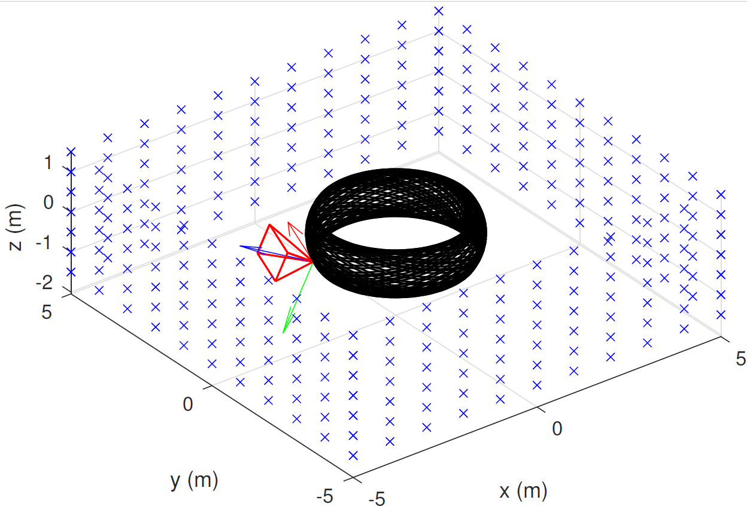
Simulation results
Notes:
The consistency of the proposed FLS is verified with simulation for the VI SLAM problem.
For simulation, the camera-IMU system moves in a virtual room while fully exciting all axes of the IMU.
The right plot shows that the proposed RI-FLS achieves consistent NEES values close to the theoretical value similarly to iSAM.
On the other hand, traditional incremental FLS and batch FLS have NEES grow over time.

Slide 20
Real data results
Absolute translation error averaged over 3 runs on sample EuRoC datasets
RI-FLS MH_01
RI-FLS MH_05
Notes:
We also tested the RI-FLS and the traditional incremental FLS on the EuRoC benchmark.
We see that RI-FLS achieves similar accuracy to Inc. FLS.
The right plots show topviews of estimated trajectories by RI-FLS on two sample datasets.

Slide 21
Conclusion
Right invariant fixed-lag smoothers are consistent.
Landmark parameters in a camera frame, IMU biases, etc., do not impact consistency.
RI-FLS achieves consistency in simulation and works with real data.
Notes:
To conclude, we prove that right invariant FLS are consistent. As a byproduct, we show that
Local parameters, like landmarks expressed in a camera frame, and IMU biases does not affect consistency.
The consistency of RI-FLS is verified by simulation. And its practicality is verified on the EuRoC benchmark.

Slide 22
Future work
Will marginalization cause observable dimensions to gain spurious information?
Use keyframe-based schemes to enhance accuracy.
Notes:
In the future, we will look into whether marginalization cause observable dimensions to gain spurious info.
And we shall use keyframe-based schemes to further improve accuracy of the proposed RI-FLS.
What about left invariant errors?

Slide 23
Questions are welcome!
Thank you!
Notes:
Thank you for your attention. Your questions are welcome.

